Slide 1
Tangling With Tools:
Automatically Managing Dependencies Within Cloud SIG
Javier Peña (jpena@redhat.com)
Alfredo Moralejo (amoralej@redhat.com)
19-October-2018

Slide 2


Introduction
RDO developers @ Red Hat
Take care of
  Packaging
  Automation / CI
  Infra

Slide 3
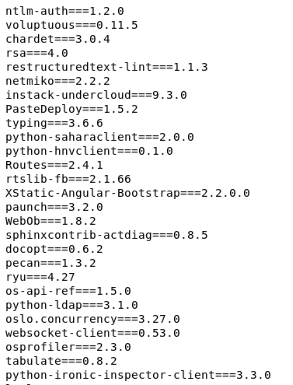
Managing OpenStack dependencies
OpenStack supports hundreds of dependencies
  All included in the requirements repo
This is a fast moving target
  New dependencies every now and then
  Bots proposing new versions of dependencies when released on PyPi
Each OpenStack release has different dependencies
  And versions!

Slide 4

So doing it manually felt like...

Slide 5
Cloud SIG (RDO) dependency policy
RDO can consume deps from different repos:
If it’s in CentOS base or extra, just use it!.
  Don’t provide newer versions of packages in base unless it’s totally required.
If it’s provided by other CentOS SIG, consume it from there.
  Add other’s SIG repo as dependency for RDO. i.e.: VirtSIG or StorageSIG.
  Cross-tag builds from other SIGs in RDO CBS tags.
If it isn’t in CentOS base nor SIGs, rebuild it in CBS from Fedora build.
If pure rebuild from Fedora does not work, fork Fedora distgit in RDO and rebuild it.
  Examples: removing python3 builds, etc...

Slide 6

Proposal
Be proactive
  Monitor changes to the requirements repo
Be automated
  Automatically react on changes to requirements repo
  Create automated builds on CBS, using CI jobs
Be tested
  Do not tag updated dependencies unless
    Scratch build works fine
    CI jobs are successful

Slide 7
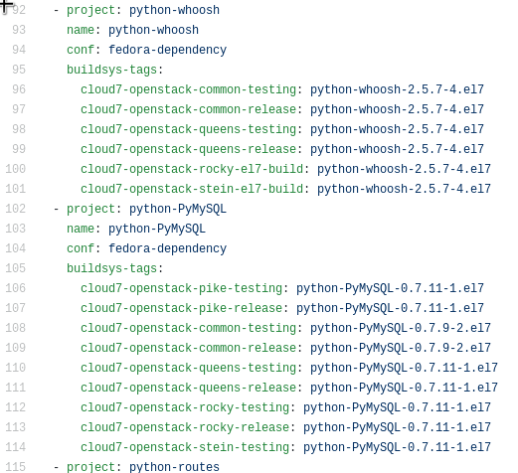

Our toolset
Software Factory:
Gerrit for code review
Zuul + Nodepool for CI
rdoinfo

Slide 8
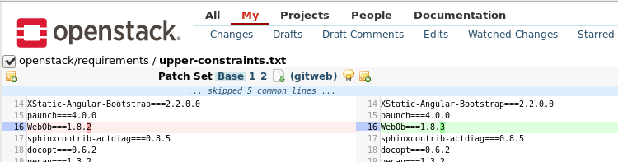
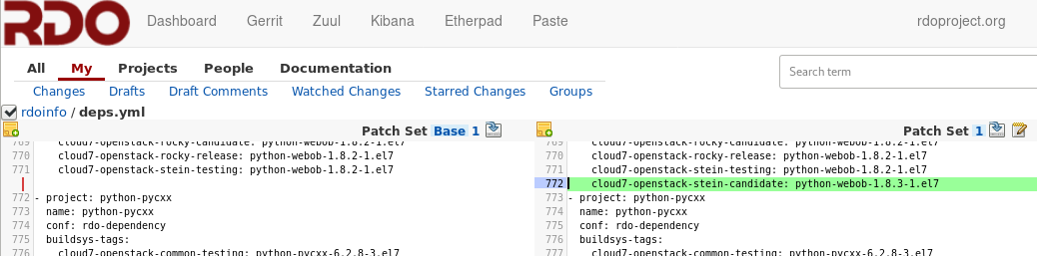
Monitor upstream changes
New/updated dep upstream:
  Periodically dependencies are updated with latest available releases.
  Upstream jobs are executed to ensure OpenStack services keep working.
  Once merged a review is created in rdoinfo to propose update in RDO deps repo using cloud7-openstack-<release>-candidate

Slide 9
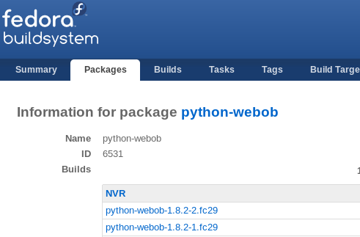
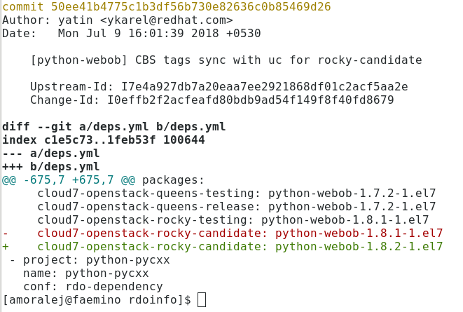
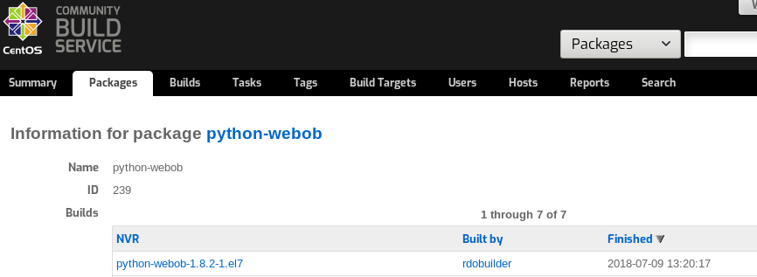
Automate CBS builds
When a review updates/adds a cloud7-openstack-<release>-candidate tag, check jobs look for suitable build in Fedora with similar NVR:
  If exists a scratch rebuild is tried in CBS
  If not ready yet allow us to request for update in Fedora

Slide 10
CI-based promotion
When a new package is built it’s tagged into cloud7-openstack-<release>-candidate
  Packages are not published in any repository
Packages tagged into cloud7-openstack-<release>-testing are published to be tested and used in CI Jobs for under development releases in buildlogs.
Packages tagged into cloud7-openstack-<release>-release are signed and published to official CentOS mirrors.
Before pushing packages into -testing or -release tags we need to ensure they work as expected.
  Packages tags are maintained in rdoinfo database.
  Package tagging is automatically done when merging patches on rdoinfo.
  A set of CI jobs, including OpenStack deployments are executed in rdoinfo gates before merging patches.

Slide 11
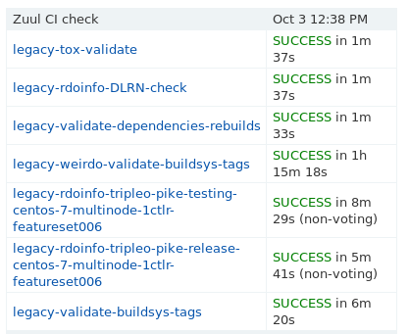
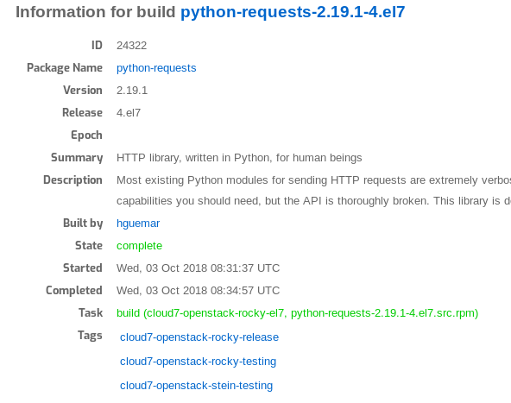
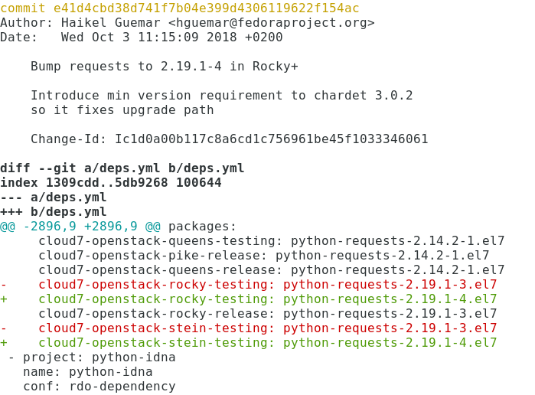
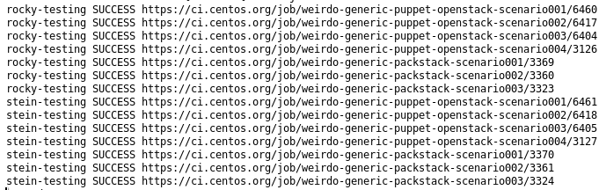
CI-based promotion (II)

Slide 12
Q/A

